Slide 1
IMAGE CLASSIFICATION
BY- ANURAG KUMAR

Slide 2

IDEA
Images are one of the major sources of data in the field of data science and AI. This field is making appropriate use of information that can be gathered through images by examining its features and details. We are trying to give you an exposure of how an end-to-end project is developed in this field
Idea behind this project is to build a deep learning-based Image Classification model on images that will be scraped from e-commerce portal. This is done to make the model more and more robust.

Slide 3
Task Division
Data Collection
Mode Building

Slide 4
Data Collection Phase
Scraped images from e-commerce portal, Amazon.com. The clothing categories used for scraping will be:
Sarees (women)
Trousers (men)
Jeans (men)

Slide 5
Model Building Phase
After the data collection and preparation is done, I build an image classification model that will classify between these 3 categories mentioned above.
I played around optimizers and learning rates for improving your model’s performance using-
BATCH_SIZE = 32
IMAGE_SIZE = 256
CHANNELS=3
EPOCHS=50

Slide 6
IMAGE CLASSIFICATION APPROACH
Transfer Learning- (VGG16)
A CNN architecture that is 16 layers deep.
It load a pertained version of the network trained on more no. of images.
The pertained network can classify image into 1000 object categories.

Slide 7
Model Compilation & KEYS
optimizer='adam',
loss=tf.keras.losses.SparseCategoricalCrossentropy(from_logits=False),
metrics=['accuracy’]
KEYS= ['loss', 'accuracy', 'val_loss', 'val_accuracy’]

Slide 8
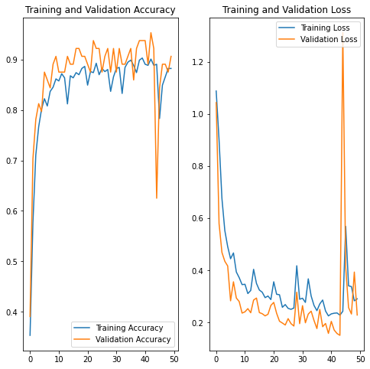
MODEL EVALUATION

Slide 9
MODEL SUMMARY
Model Score- loss: 0.2625 - accuracy: 0.9167
Parameters- 'epochs': 50, 'steps': 16, 'verbose’: 1
Activation function- relu & softmax

